Slide 1
CSE 3100: Systems Programming
Lecture 8 : Linked Lists, Enums and Function Pointers
Department of Computer Science and Engineering
University of Connecticut

Slide 2
1. Linked Lists and Structures
Today’s Lecture Topics
2. Enumeration Types and Constants
3. Function Pointers

Slide 3
1. Linked Lists and Structures

Slide 4
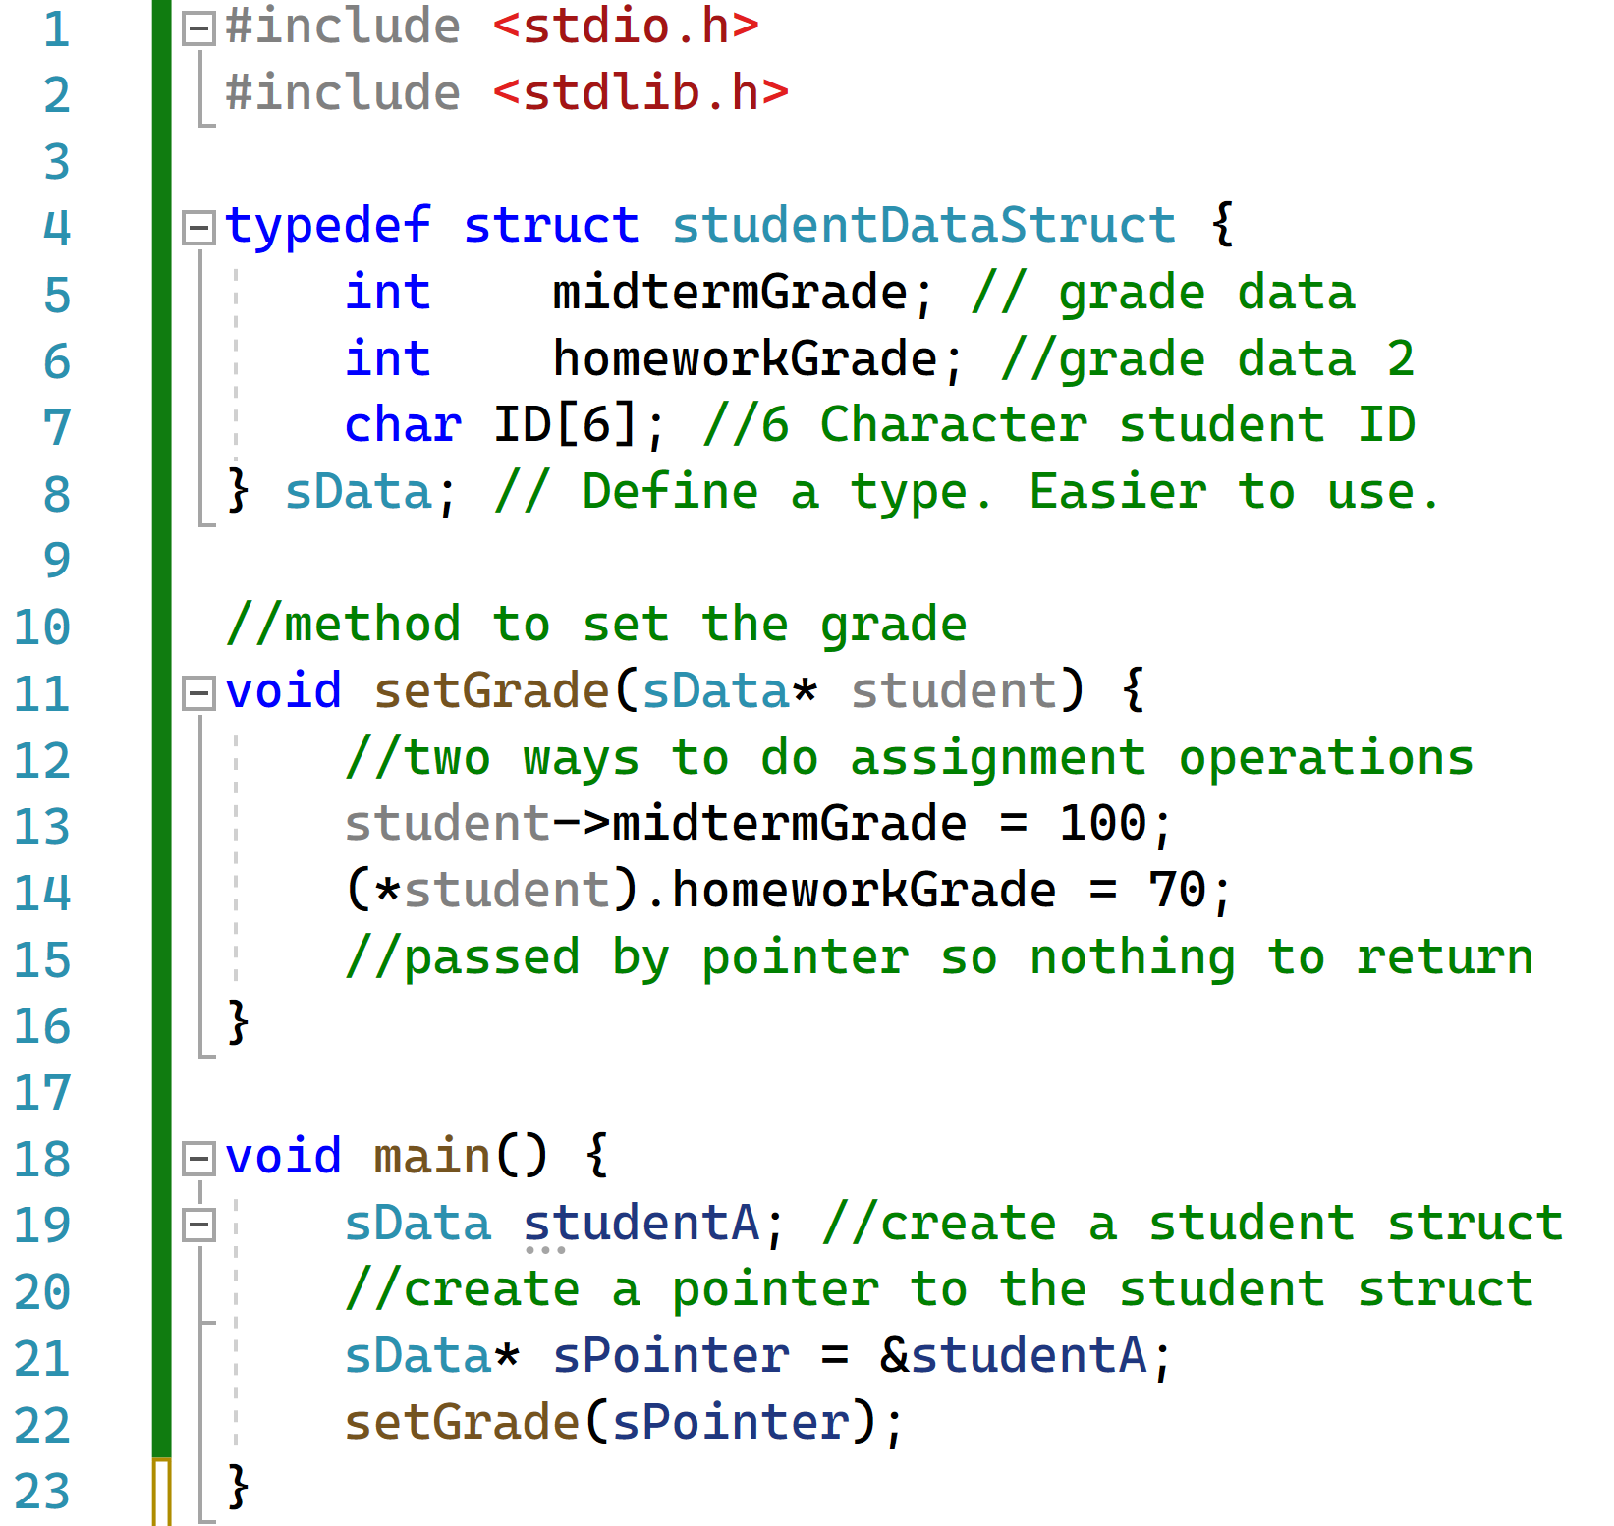
Review from last lecture…structures
Here we define a student structure and some related variables

Slide 5
Structures Example
In main create an instance of the student structure and call the set grades function.

Slide 6
Structures Example
Here we have the set grades function where we take a pointer to a student object.
Note how C allows TWO different (but operationally equal) ways to set the variables of a structure when only a pointer is given.

Slide 7
Structures Example Entire Code
Code to define a structure
Function that operates on a pointer to a structure
Main where we instantiate the structure

Slide 8

Structures in C in practice: Linked Lists

Slide 9

Singly Linked Lists
Terminator
Linear collection of data elements as nodes.
Each node contains a value and a pointer to the next element.
The last element points to a terminator to show that the end of the list has been reached.
Figure Source: https://upload.wikimedia.org/wikipedia/commons/thumb/6/6d/Singly-linked-list.svg/1920px-Singly-linked-list.svg.png

Slide 10
Simple Single Linked List Example
New Element
5
Inserting at the head of the list is easy! What is the time complexity?
5
O(1)
Now I want to insert at an arbitrary location, e.g. after node value 37. What is the time complexity?
O(n)
5

Slide 11

Linked Lists
// A data structure that consists of a chain of nodes
// Starting from head, a node has a reference to the next node
typedef struct node_tag {
int v; // data
struct node_tag * next; // A pointer to this type of struct
} node; // Define a type. Easier to use.

Slide 12

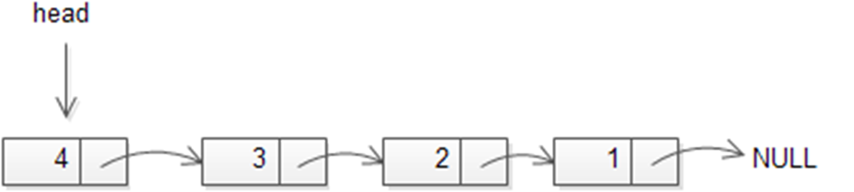
Linked List Head
node * head; // head is a pointer, not a node!
head = NULL; // at beginning, it is empty
After adding nodes into the list:

Slide 13
Creating a Node
V
node * new_node(int v) // create a node for value v
{
node * p = malloc(sizeof(node)); // Allocate memory
assert(p != NULL); // you can be nicer
// Set the value in the node.
p->v = v; // you could do (*p).v
p->next = NULL;
return p; // return
}

Slide 14
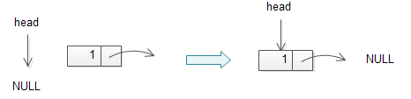
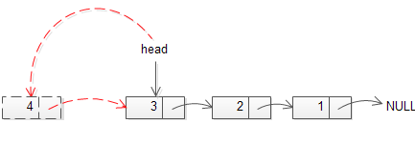
Adding a new node to a linked list (Prepend)
When the linked list starts as empty:
When you want to replace the head:

Slide 15
Adding a new node to a linked list (Prepend)
node * prepend(node * head, node * newnode)
{
newnode->next = head; // works even if the list is empty
return newnode; // head changed !!
}

Slide 16

How to find the last element of a linked list?
node * find_last(node * head)
{
// How?
}

Slide 17
How to find the last element of a linked list?
node * find_last(node * head)
{
if (head != NULL) { // only if the list is not empty
while (head->next != NULL)
head = head->next;
}
return head;
}

Slide 18
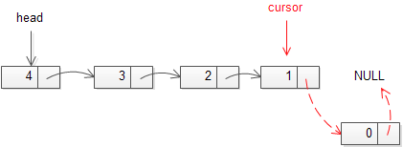
Adding a new node to a linked list (Append)
What if we want to add a new node to the end of list?
last

Slide 19
Adding a new node to a linked list (Append)
last
node * append(node * head, node * newnode) {
node *last = find_last(head); // find the last one
if (last == NULL) // if the list is empty, newnode is the head
return newnode;
last->next = newnode;
newnode->next = NULL;
return head; // return the (unchanged) head
}

Slide 20
Arrays vs Linked Lists
Array | Linked List
Fixed Size, Resizing Expensive | Dynamic Size
Memory allocated in advance | Memory allocated dynamically
Sequential access fast | Sequential access slow (elements not in contiguous memory location)

Slide 21
2. Enumeration Types and Constants

Slide 22
Enumeration types
The keyword enum is used to declare enumeration types.
Treated as integers.
By default the first one is 0, and each succeeding one has the next integer value.
Names look like C identifiers
User-defined integer-like types:
  typedef enum {
  Red, Orange, Yellow, Green, Blue, Violet
  } Color;

Slide 23
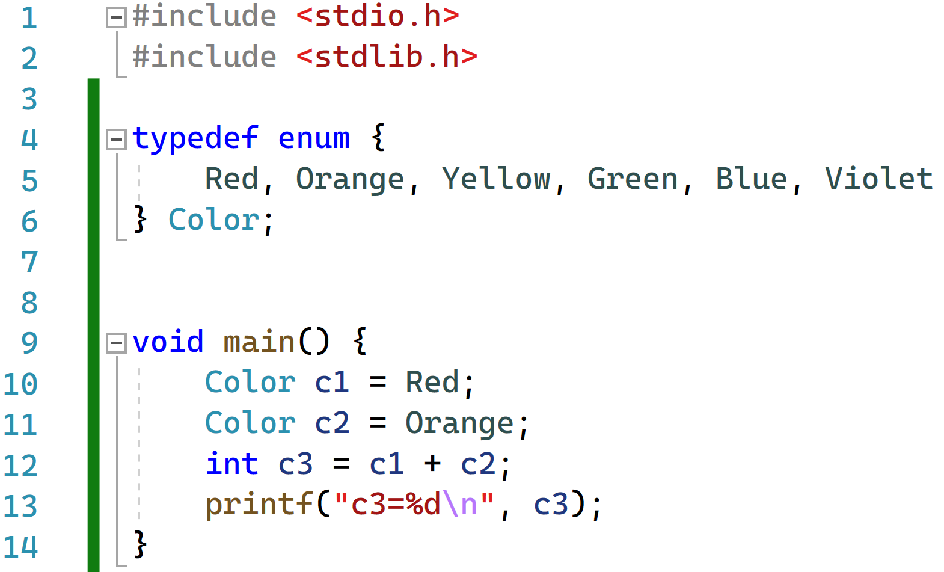

Enum Code Example
Technically has a value of 0
Technically has a value of 1

Slide 24

What is the point of enums?
“The entire point of enums are to make your code more readable….instead of going back and forth checking what int values you may have, you can have a clear set of enums to make the code more readable.”
Enums = syntactic sugar
Programmers first
hearing about enums:
Source: https://stackoverflow.com/questions/8010492/what-is-the-point-of-enums

Slide 25
Type qualifier: const (1)
// constant int
const int a = 10; // cannot change a
// a pointer to a constant int
const int *pa = &a; // can change pa, but not *pa

Slide 26
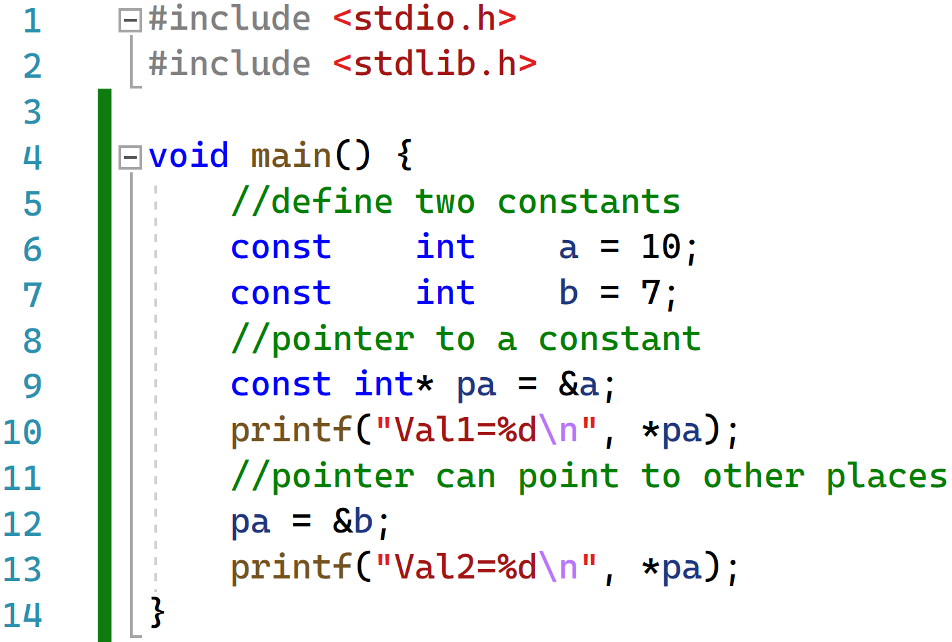

Constant Code Example 1
A pointer to a constant is NOT constant. So we can make pa point to a, then we can make pa point to b.

Slide 27
Type qualifier: const (2)
// a constant pointer to an int
int * const pb = &b; // can change *pb, but not pb
// a constant pointer to a constant int
const int * const pc = &a; // cannot change *pc or pc

Slide 28
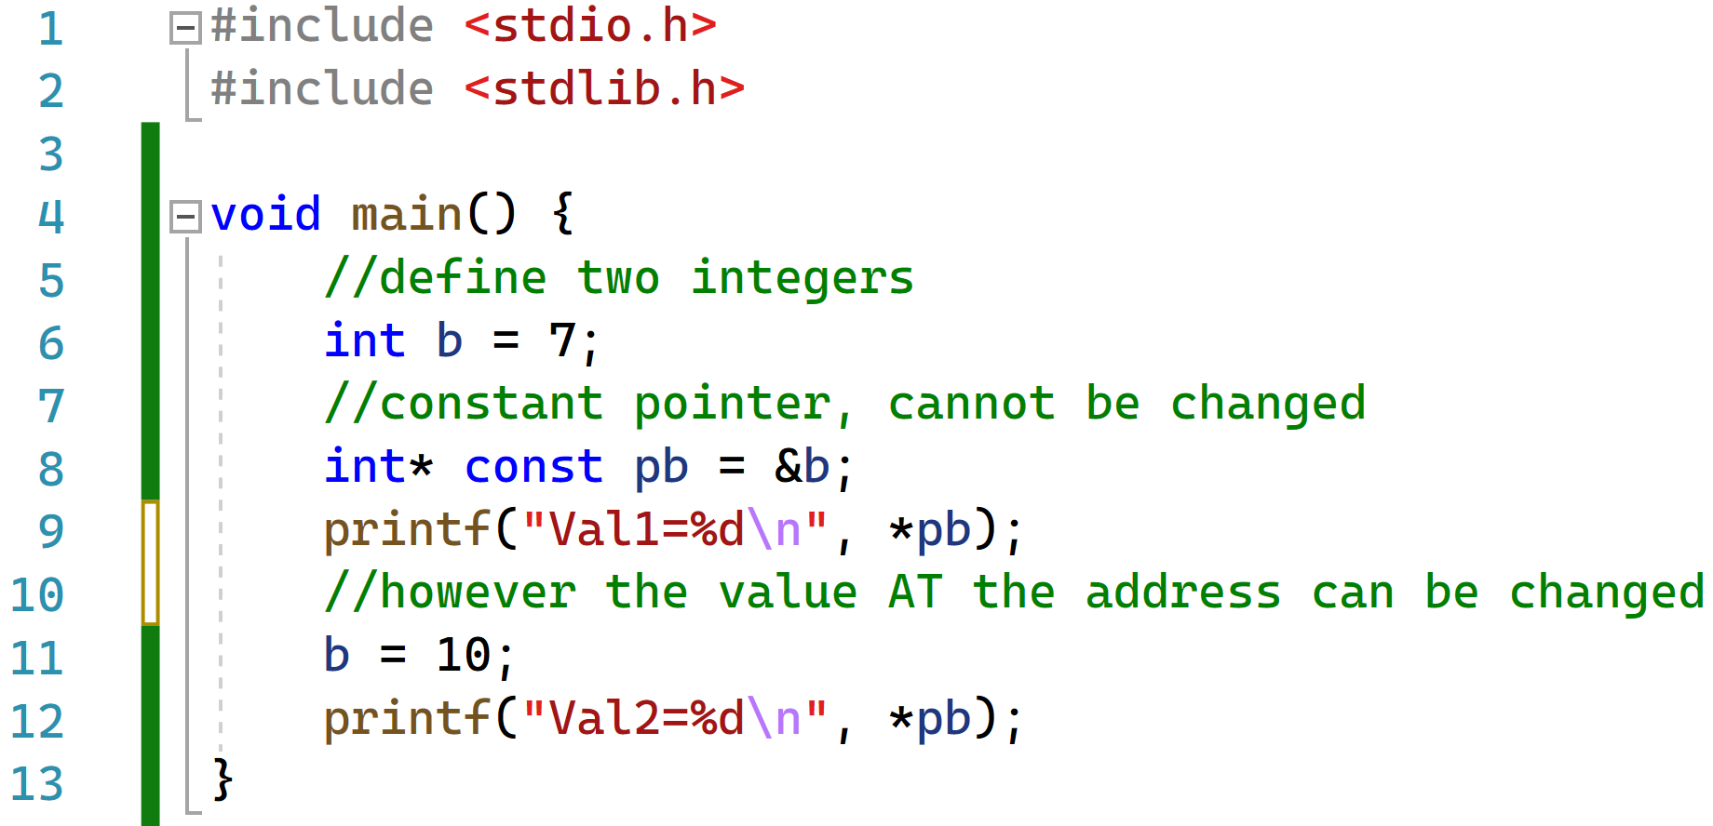

Constant Code Example 2
A constant pointer is CONSTANT and cannot be changed.
i.e. it always points to one fixed address in memory
However, we can change what is stored AT that address.

Slide 29

3. Function Pointers
Least complicated pointer program in C:

Slide 30
Function Pointers
/* function returning integer */
int func();
/* function returning pointer to integer */
int * func();
/* pointer to function returning integer */
int (*func)();
/* pointer to function returning pointer to int */
int * (*func)();

Slide 31
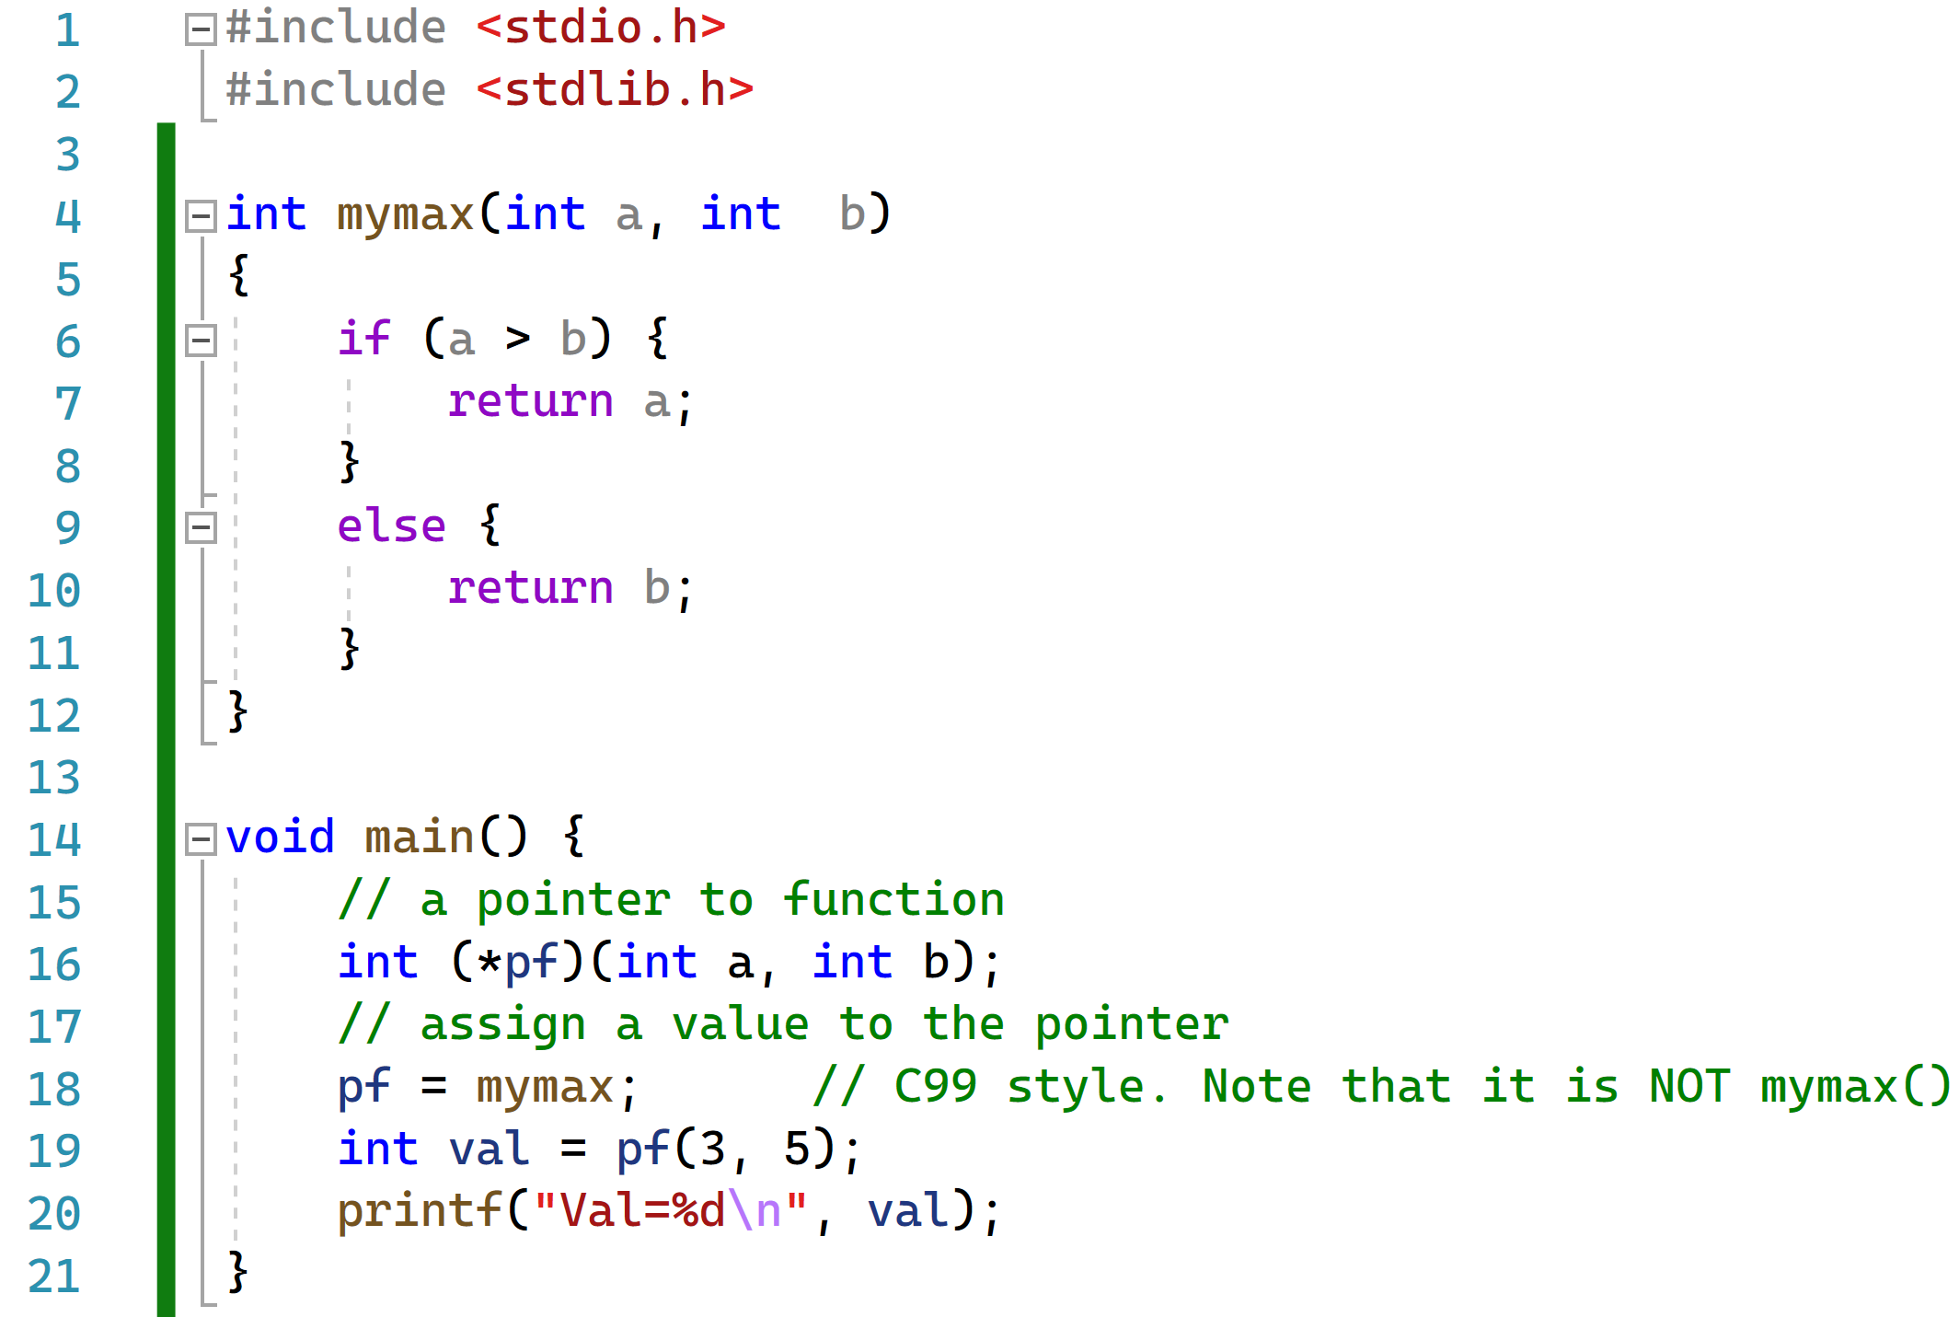

Example of using a pointer to a function

Slide 32
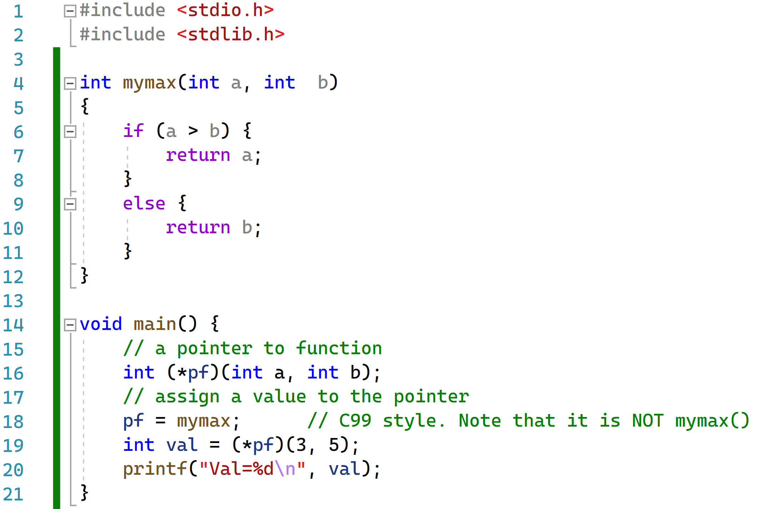
Alternative Syntax for using a pointer to a function
Why do we care about such complicated behavior?

Slide 33
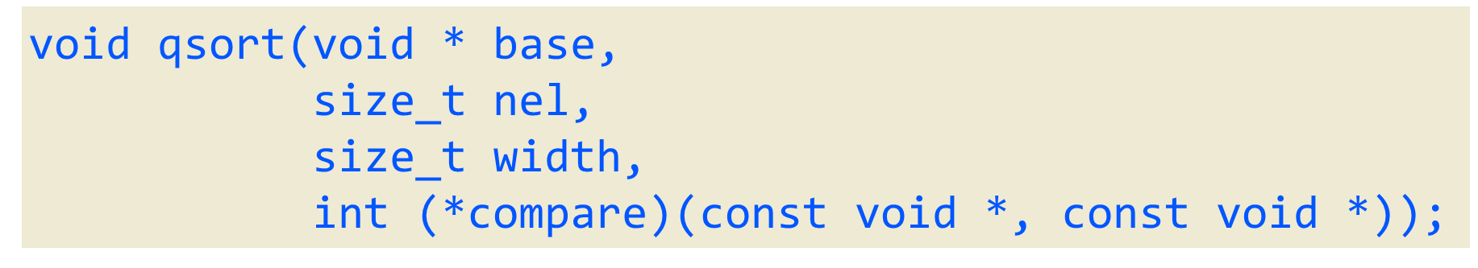
Example: quicksort in C library
The prototype (in <stdlib.h>)
qsort takes…
  base: the address of the array as an untyped pointer
  nel: the number of elements in the array
  width: the size (in byte) of ONE element of the array
  compare: a pointer to a function that compares two values
Why is having a pointer to a function good?

Slide 34
Why is having a pointer to a function good?
qsort() only knows it is asked to sort nel items, each having width bytes.
It does not know the type of elements or how to compare them.
Need to tell qsort() how to compare items in the array
  We have a generic quickSort implementation
    Do not want to implement one for each type of data
The qsort() implementation calls the comparator to rank elements
int (*compare)(const void *a, const void *b);
  The function takes the address of two items to be compared,
  and returns:
    0 if *a EQUALS *b
    A positive value if *a is GREATER THAN *b
    A negative value if *a is LESS THAN *b

Slide 35
Example of the Compare Function
When qsort() needs to compares two items, it provides their addresses
int compare_int(const void *a, const void *b)
{ // qsort() does not know the type, but you know
return *(int *)a - *(int *)b;
}
int compare_double(const void *a, const void *b)
{ // qsort() does not the type, but you know
double va, vb;
va = *(double *)a; vb = *(double *)b;
return va > vb ? 1 : (va < vb ? -1 : 0);
}

Slide 36


Lecture Conclusions
Conclusion 1: You should understand the linked list and how using a pointer to denote the head makes manipulation of the nodes straight forward.
Conclusion 2: Understand how to use enumerators and constants.
Conclusion 3: Start to understand how we can pass functions as pointers for flexible coding.

Slide 37
Figure Sources
Figures for linked list are from http://www.zentut.com/c-tutorial/c-linked-list/
https://programmercave0.github.io/assets/Memes-Linkedlist/llmeme2.jpg
https://programmercave0.github.io/assets/Memes-Linkedlist/llmeme6.jpg
https://akashicseer.com/wp-content/uploads/2022/02/pirate-what-is-this-fool.jpg
https://www.idlememe.com/wp-content/uploads/2021/10/spiderman-pointing-meme-idlememe-2.jpg

